Slide 1


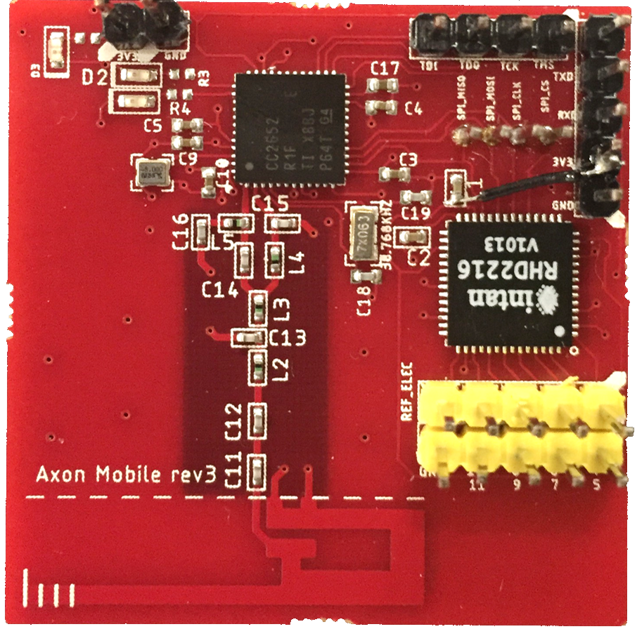

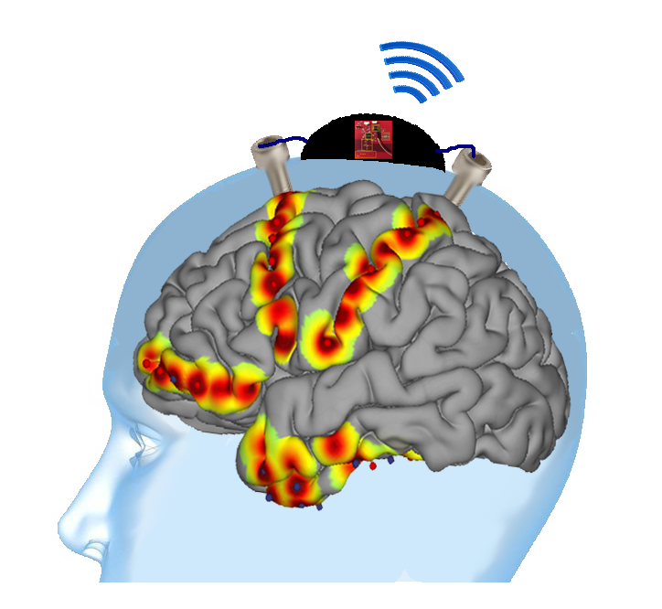
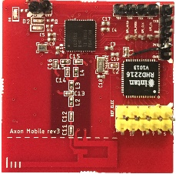

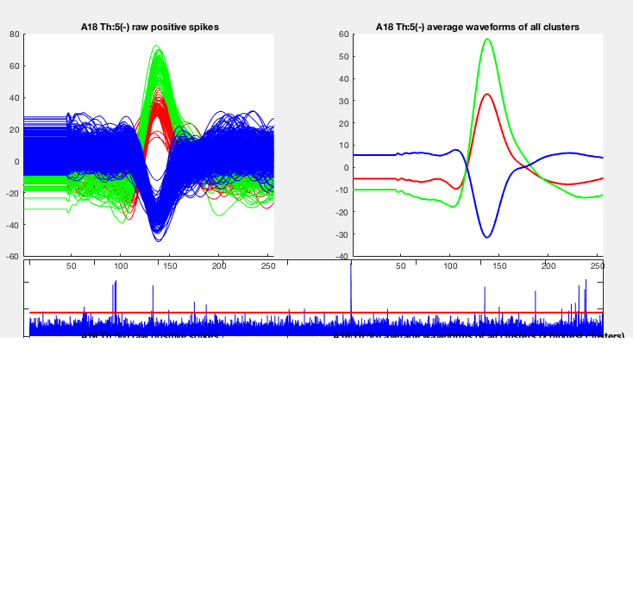
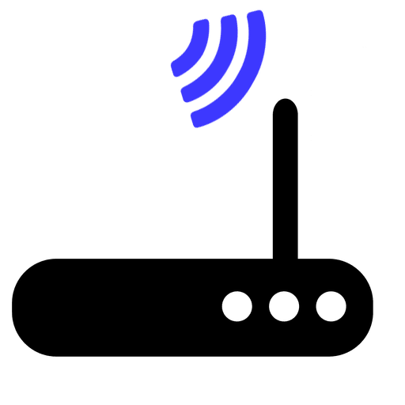
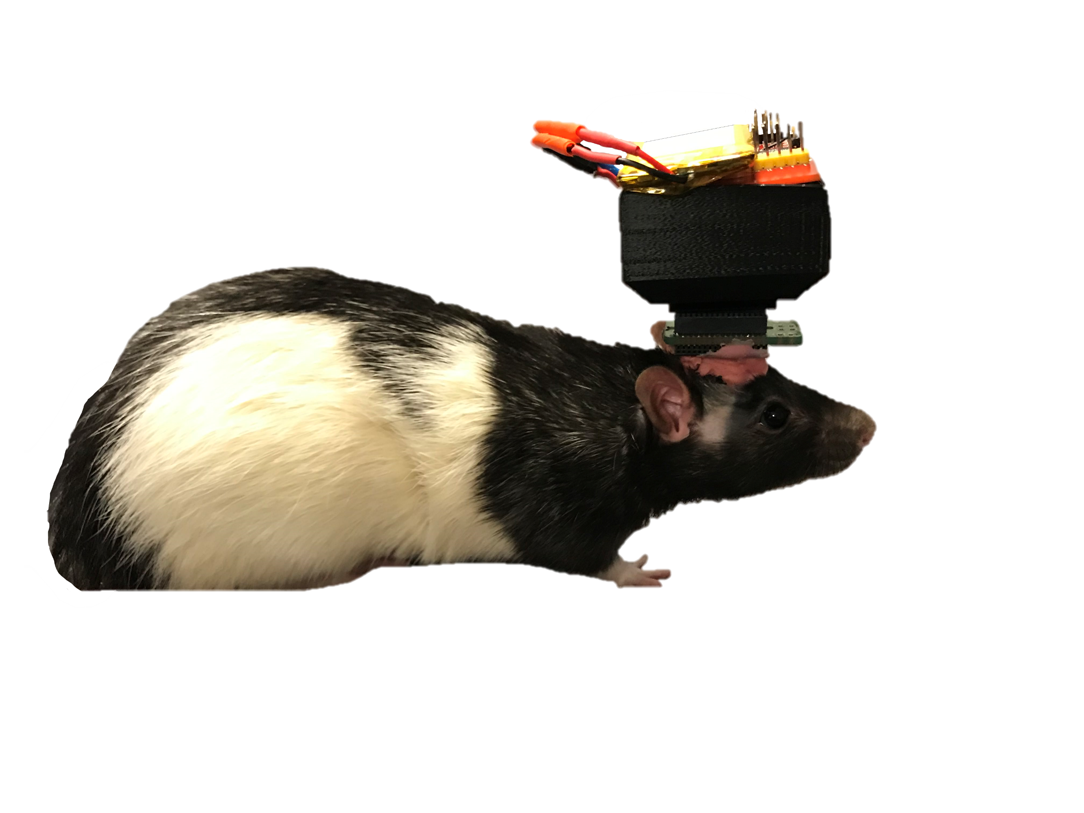
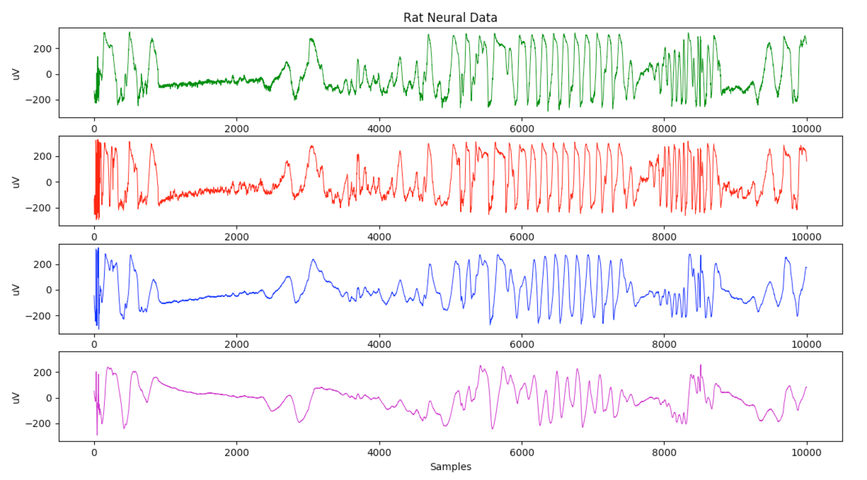

Wireless Recorder for Epileptic Seizure Monitoring
Aidan Curtis, Sophia D’Amico, Andres Gomez, Benjamin Klimko, Zhiyang Zhang
Rice University Electrical & Computer Engineering | riceaxonmobile@gmail.com
Motivation
Prototype Design
Screen Shot 2019-03-26 at 11.37.35 PM
30% of epilepsy patients do not respond to traditional treatment [1]
Patients are treated with neural implants to locate regions of seizure activity
Current recording solution is wired, which is:
Board Design
4x4 centimeters, 4 layers
16 data channels with 16-bit ADC
Connects to electrode interface board implanted in a rodent brain
Compression
Two types of neural data:
- Local field potentials (LFP)
- Action potentials/spikes (AP)
Predictive modeling used for LFP data
- Reduces signal entropy, which
reduces overall signal size
- Can achieve x2 compression
Novel compressive sensing algorithm used for AP data
- Exploits underlying signal sparsity
- Can achieve x12 compression
Infection-prone
Expensive
Psychologically damaging
3
1. Electrode test pins
2. Digital interface chip to
collect neural data
3. Wireless chip
4. Transmission line
5. Integrated inverted F
antenna
Design Specifications
2
PROBLEM: Tethered neural recording system hampers patient well-being
SOLUTION: A scalable wireless recorder that transmits neural data from implanted electrodes to an external receiver
4
1
5
Neural Spike Clusters
Averaged Spike Clusters
Objective | Target | Progress
Multi-channel | 16-channel | ✓
Battery life | 24 hours | ~20 hours
Resolution | 8-bit ADC | ✓
Wireless range | ≥ 1m | ✓
Sampling rate | ≥ 1kHz | ✓
Novelty | Compression algorithm | ✓
Wireless
CC2652 multi-protocol chip
2.4GHz Proprietary RF for data transmission
Transmission range of 15m
Adjustable sampling rate from 480Hz – 1kHz
Throughput of 120kbps
visualization of decompressed neural data
Successful Rodent Implantation for Proof of Concept
Better Quality of Life for Epileptic Patients
Final prototype tested in a rat; encapsulated in a 3D-printed cap connected to implanted electrodes
Successfully collected 4 channels of rat neural data, with 16 channels possible
Entire system: 45g
Wireless, novel neural recorder fully functional in rodents
Can be used for research in rodents, and is scalable to humans
Seamlessly integrates into the implantation process in rodents
Easy to visualize and analyze collected neural data
Allows for patient mobility, which decreases hospital stay, cost, and chance of infection; increases quality of life
4x4cm board
500mAh battery
3D-printed cap
Acknowledgements / References
This work was supported by funding from the OEDK and sponsorship from Altium. We give special thanks to Dr. Nitin Tandon of UT Health for inspiration and guidance, Dr. Caleb Kemere, Ziying Chen, and Shayok Dutta from the Rice University RNEL for assisting us in our rodent experimentation, and Dr. Gary Woods for guidance and technical assistance.
[1] World Health Organization, “Epilepsy,” www.who.int, Feb. 7, 2019. [Online]. Available: https://www.who.int/news-room/fact-sheets/detail/epilepsy. [Accessed: Feb. 20, 2019].
All work with vertebrate animal subjects is approved by Rice IACUC.
The pink material on top of the rat’s head is dental acrylic, commonly used in dentures.

